Slide 1
Model-based Integrated Planning and Control of Autonomous Vehicles using Artificial Potential Fields with uncertain environment
25th February 2022
Discussion on the problems with SMPC
^{Emilio Benenati}
^{Josyula Viswanath Das}

Slide 2
Three ways to move forward.

Slide 3
Three ways to move forward.
One is to complete the design of the present SMPC controller and then say that because of safety guarantees which can be given at only a given confidence level we must see that in the future an addition backup/ fail-safe controller has to be used

Slide 4
Three ways to move forward.
Second is to use add a Failsafe Trajectory planning controller along with the SMPC based controller to check at each time step if the calculated set of optimal control inputs can take us to a safe area ^{[1]}
^{[1]} T. Brudigam, M. Olbrich, D. Wollherr, and M. Leibold, “Stochastic Model Predictive Control with a Safety Guarantee for Autonomous Driving,” IEEE Transactions on Intelligent Vehicles, pp. 1–21, 2021.

Slide 5
Definitions required:
Safe State: The state of the host vehicle (HV) is called a safe state if
the vehicle is fully located in one lane
no lateral vehicle motion ( heading angle, φ=0)
v_{HV}<v_{OV} in the same lane or v_{HV}=0
Safe input sequence: An input sequence, U_{safe}= [u_{safe,0}, u_{safe,1}, u_{safe,2},…u_{safe,m}] where m is not directly related to the prediction horizon of the MPC optimization problem is called a safe input sequence if applying all elements of U_{safe} leads to a collision-free trajectory with the final velocity v_{HV,final}=0

Slide 6
The code works as follows:
given the current state of the HV and OV are available.
current state of the HV is a safe state.

Slide 7
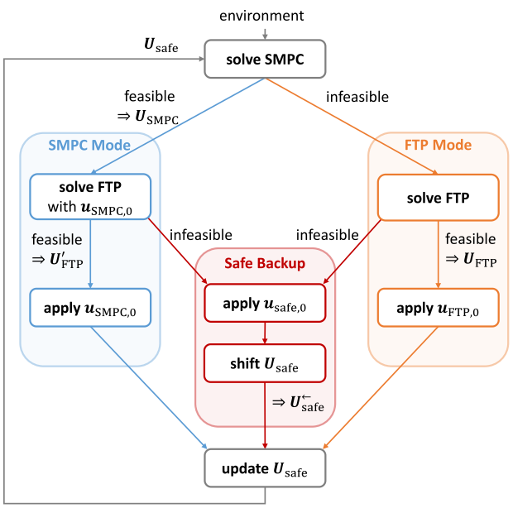

Slide 8
SMPC OCP
Predict the OV state,
Calculate the safe vehicle area around each obstacle using the data based on the distribution of the noise.
Generate chance constraints and then rewrite them as linear constraints based on the relative location of the obstacles and the HV and the safe vehicle areas.
Final SMPC OCP

Slide 9
FTP OCP
Generate a maximal reachable set of the OV’s based on an initial state set (which is based on sensor uncertainty),
Generate linear constraints based on the relative location of the obstacles and the HV and the reachable sets
Generation of an FTP Terminal set. This is in case all the inputs in U_{safe} are used up and acts as an emergency strategy.
Final FTP OCP

Slide 10
Three ways to move forward.
Not use SMPC but rather use RMPC ^{[2]}
^{[2]} S. Dixit, U. Montanaro, M. Dianati, D. Oxtoby, T. Mizutani, A. Mouzakitis, and S. Fallah, “Trajectory Planning for Autonomous High-Speed Overtaking in Structured Environments Using Robust MPC,” IEEE Transactions on Intelligent Transportation Systems, vol. 21, no. 6, pp. 2310–2323, 2020.

